Slide 1
FCN (Firmware Change Notice)
[ PM983 M.2 SED SSD ]
Feb 3, 2020
Memory Quality Assurance
THIS DOCUMENT AND ALL INFORMATION PROVIDED HEREIN (COLLECTIVELY, “INFORMATION”) IS PROVIDED ON AN “AS IS” BASIS AND REMAINS THE SOLE AND EXCLUSIVE PROPERTY OF SAMSUNG ELECTRONICS CO., LTD. CUSTOMER MUST KEEP ALL INFORMATION IN STRICT CONFIDENCE AND TRUST, AND MUST NOT, DIRECTLY OR INDIRECTLY, IN ANY WAY, DISCLOSE, MAKE ACCESSIBALE, POST ON A WEBSITE, REVEAL, REPORT, PUBLISH, DISSEMINATE OR TRANSFER ANY INFORMATION TO ANY THIRD PARTY. CUSTOMER MUST NOT REPRODUCE OR COPY INFORMATION, WITHOUT SPECIFIC WRITTEN CONSENT FROM SAMSUNG. CUSTOMER MUST NOT USE, OR ALLOW USE OF, ANY INFORMATION IN ANY MANNER WHATSOEVER, EXCEPT FOR CUSTOMER’S INTERNAL EVALUATION PURPOSE. CUSTOMER MUST RESTRICT ACCESS TO INFORMATION TO THOSE OF ITS EMPLOYEES WHO HAVE A BONA FIDE NEED-TO-KNOW FOR SUCH PURPOSE AND ARE BOUND BY OBLIGATIONS AT LEAST AS RESTRICTIVE AS THIS CLAUSE. BY RECEIVING THIS DOCUMENT, IT IS UNDERSTOOD THAT CUSTOMER AGREES TO THE FOREGOING AND TO INDEMNIFY SAMSUNG FOR ANY FAILURE TO STRICTLY COMPLY THEREWITH. IF YOU DO NOT AGREE TO ANY PORTION OF THIS CLAUSE, PLEASE RETURN ALL INFORMATION AND ALL COPIES (IF ANY) WITHIN 24 HOURS OF RECEIPT THEREOF.

Slide 2
FW Change Summary
The purpose of changing FW
  Firmware optimization and bug fixes : Details of changes are described in next pages
Affected product and Firmware version
Samsung complete the Qualification Tests for the new Firmware on 28th Jan 2020.
Cut In Date on Mass Production : will be updated soon
SSD product | P/N | FW
 |  | AS Is | To Be
PM983 NVMe SSD 1/2TB | MZ1LB960HAJQ-00007 MZ1LB1T9HALS-00007 | EDA7502Q | EDA7602Q
PM983 NVMe SSD 4TB | MZ1LB3T8HMLA-00007 | EDB7502Q | EDB7602Q

Slide 3
FW Change – Change items Summary
Description of Change Items (EDA/EDB7602Q)
No | Item Description | Severity | Likelihood
1 | META block UECC improvement @SPO w/o IO | Medium | Low
2 | Device Missing after Hot-plug (DRS disable) | Medium | Low
3 | SMART IO impact improvement | Low | Low
4 | NM Code Refresh | Medium | Low
5 | Increasing CRC Count improvement after Power Cycle | Low | Low
6 | Unexpected increase of SPOR count improvement in SMART | Medium | Low
7 | Supports Set Feature that initializes CRC Error Count (FID 0xCA) | N/A | N/A
8 | Supports Set Feature that initializes Number of Error Log (FID 0xCB) | N/A | N/A
9 | Wear-leveling improvement under specific condition (Sustained + hot-spot write) | Medium | Low
10 | Improved CRC Error Count increase during FW Activate w/o POR | Medium | Low
11 | Ref.CLK buffer change (85mV → 115mV) (Gen 1 drop improvement) | Medium | Low

Slide 4
META block UECC improvement @SPO w/o IO
Meta Reserved Block Allocation Policy Change
  Use round-robin allocation from spare blocks when meta active block reclaim.
  Using all reserved blocks evenly to prevent Erase counts increment on specific block.
Meta Active Block Close when SPO open
  After reclaim, close current meta active block and replace active block.
  Meta Active Block will be changed by every SPO, expect to have the same average Erase Counts so that FW can apply accurate Adaptive Core value.
Reclaim
1. Meta Active Block
Reclaim
Meta Block
10
Meta Block
11
Meta Block
12
Meta Block
13
Meta Block
14
Reserved Block 19
Reserved Block 20
Active Block
2. Meta Active Block
Close
Meta Block
10
Meta Block
11
Meta Block
12
Meta Block
19
Meta Block
14
Reserved Block 13
Reserved Block 20
Close
Active Block
3. I/O Run
Meta Block
10
Meta Block
11
Meta Block
12
Meta Block
19
Meta Block
14
Reserved Block 13
Reserved Block 20
SPO
Close
Active Block
Reclaim
4. Meta Active Block
Reclaim & Close
Meta Block
10
Meta Block
11
Meta Block
12
Meta Block
19
Meta Block
20
Reserved Block 13
Reserved Block 14
Active Block
Close
Avg EC increase

Slide 5
Device Missing after Hot-plug (DRS disable)
Failure symptom
  PM983 did not appear as NVMe/PCIe device after hot-insertion (Hot-plug).
Root cause analysis
  After hot-insertion and link-up, PM983 sends Device Readiness Status (DRS) message TLP.
  Some host system did not configure PCIe Configuration Space of PM983 when it received DRS Msg TLP only after hot-insertion.
  DRS : It is a state where device(all function) can receive PCIe configuration request from the host
  PM983 HW DRS supported bit set as “1” (supported) as a default
  Because of this HW default, DRS Msg TLP feature is set as “1” (Enabled)
  DRS support is added in PCIe Base Spec r3.1
  Due to PCIe Base spec r3.0 compliance, DRS supported bit is disabled by FW but DRS Msg TLP feature is still enabled (Within Spec – specifieid in the spec)
  However, under such cases where hot plug takes place, some host system does not configure PCIe Configuration Space of PM983 when it received DRS Msg TLP, Thus to prevent such error, PM983 will not send DRS Msg TLP after link-up
Corrective action
  Even when DSR Supported bit is cleared(not supported), PM983 won’t send DRS message TLP after link-up.

Slide 6
SMART IO impact improvement
As-Is
  SMART CMD is executed after completion of all processing I/O CMD
  I/O CMD that received during SMART CMD processing is executed after completion of SMART CMD
To-be
  SMART CMD and I/O CMD will be executed in parallel
  Improve I/O CMD Latency
Read0
(SQ)
Read0
(CQ)
Read1
(SQ)
Read1
(CQ)
SMART (I/O Blocking)
Read0
(SQ)
Read0
(CQ)
Read1
(SQ)
Read1
(CQ)
SMART (execution with I/O)

Slide 7
NM Code Refresh
Background
  Seen bitflip in NM Code that is inside of SRAM with PM963
    If the data written in SRAM has not changed for a long time, the probability of error increases
  Though there is no history of SRAM bitflip in PM983, added the fix on PM983 as an improvement and prevention scheme
Corrective Action
  Refresh (rewrite) the data in the SRAM NM Code area periodically
  There is no impact on performance and QoS

Slide 8
Unexpected increase of SPOR count improvement in SMART
Root cause
  If there are two or more events to be handled in the exception queue that handles PCIe, the FW scheduler transition could be changed to normal. It would be recognized as SPOR if POR occurs.
  This issue reproduction is related to timing and only occurs in corner case. To reproduce this issue, consecutive PCIe events are needed to be performed within a few ms(e.g. 1ms).
Modification
  When processing consecutive PCIe events, FW scheduler is kept in non-Normal state, and it is changed to Normal only when processing Host command like NVMe.
Unintentional firmware scheduler handling and improvements for continuous PCIe events handling.
SHN
Exception Queue (Link down, PERST,…)
As is
Event
To be
Empty
Invoke shutdown
Not change scheduler transition
POR
Invoke to change scheduler to be Normal
non-Normal
(Shutdown mode)
Normal
Increase SPOR count in SMART
Scheduler to process NVMe/PCIe

Slide 9
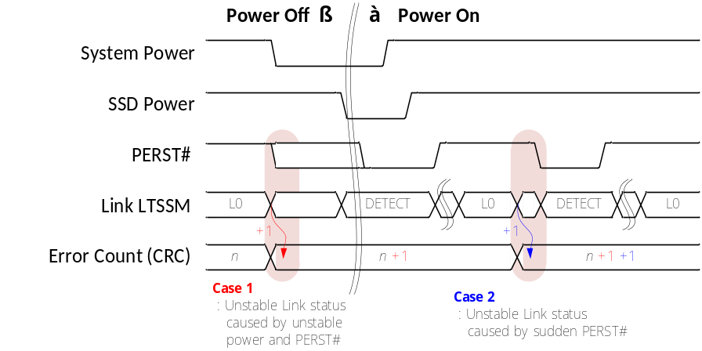
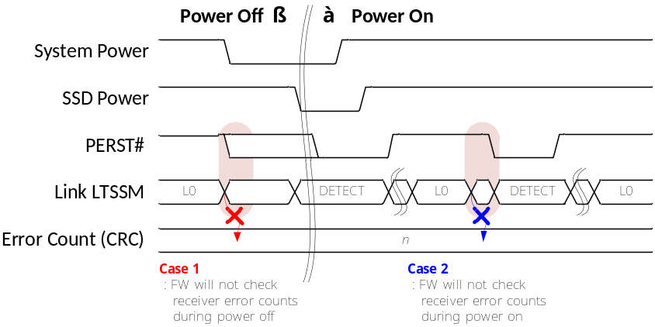
Increasing CRC Count improvement after Power Cycle
Failure symptom
  SMART CRC Error count was increased after power cycle.
Root cause analysis
  Case 1
    During power off sequence, some host system did not assert PERST# before power down. This unstable power and PERST# cause unstable link status. SMART CRC Error count could be increased by receiver errors at the time.
  Case 2
    During power on sequence, some host system suddenly asserted PERST# after link-up. And link goes to Recovery state before asserting PERST#. SMART CRC Error count could be increased by receiver errors at the time.
Corrective action
  PM983 will not check receiver error count of SMART CRC during power on and off sequence.

Slide 10
Supports Set Feature that initializes CRC Error Count
General Extended Smart CRC Error Count
  Byte [59:48]
    [50:48] : Attribute ID
    [52:51] : Normalized Value
    [59:53] : Current Raw Value
  Composed of Phy Error + Bad DLLP + BAD TLP Count
Additional supports on Set Feature (FID 0xCA)
  Initialize CRC Error Count of Extended Smart.
  CDW11 = 1(Reset Bit Setting)

Slide 11
Supports Set Feature that initializes Number of Error Log
Standard Smart Number of Error Information Log Entries
  Byte [191:176]
  Report on accumulation value of error log count in lifetime
Additional supports on Set Feature (FID 0xCB)
  Initialize Number of Error Information Log Entries of Standard Smart

Slide 12
Wear-leveling improvement under specific condition(Sustained + hot-spot write)
Failure symptom
  Hot spot write under sustained condition, wear-leveling is not performed, though it exceeds the threshold.
Root cause analysis
  After sequential Write, hot-spot random write does not trigger wear-leveling internally
Corrective action
  Added a scheme to perform wear-leveling when it exceeds the threshold.

Slide 13
Improved CRC Error Count increase during FW Activate w/o POR
Failure symptom
  When CRC error occurs after power up, and if FW is activated without POR then CRC is counted up twice.
Root cause
  After increasing the CRC count by the PCIe CRC Error Register value during FW Activation, it is increased again by the value in New FW.
Corrective Action
  Initialize PCIe CRC Error Register in New FW so that it is not increased twice
CRC Error ++5 though there is no CRC error
CRC Error count ++10
CRC Error count ++5
Old FW
POR
Old FW
FW Activate w/o POR
New FW
CRC Error Count: 10
CRC Error Count: 15
CRC Error count 20

Slide 14
Ref.CLK buffer change (85mV → 115mV) (Gen 1 drop improvement)
In order to make SSD much immune to the noise on the differential input RefClk, FW changes the differential threshold voltage of RefClk buffer from 85mVdiff to 115mVdiff.
RefClk_N
Vcommon
AS-IS : 85mVdiff
TO-BE: 115mVdiff
RefClk_P
Differential to Single-ended
RefClk buffer output

Slide 15
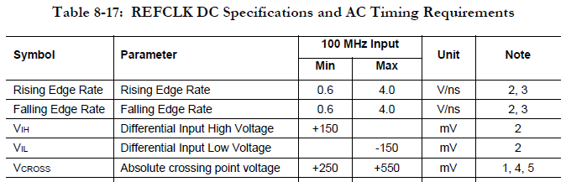
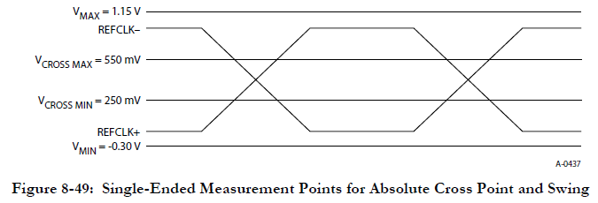
Ref.CLK buffer change (85mV → 115mV) (Gen 1 drop improvement)
About the side effect of lesser-sensitivity
  If VIH and VIL of differential RefClk meets PCIe specification, there is no known side effect of changing the threshold from 85mVdiff to 115mVdiff.
  V_{diff} should be larger than 300mV_{diff}.
  The sensitivity of 115mV_{diff} is enough to accept 300mV_{diff}.
|V_{IH}| > 150mV
|V_{diff}| > 300mV
0 V_{diff}
|V_{IL}| > 150mV

